Slide 1
Introduction to R, RStudio, and R Markdown
CHOP R 101:
Intro to R for Clinical Data
Notes:
Greetings everyone.
In this session we are going to cover an introduction to R, Rstudio, and R Markdown.

Slide 2



R
Programming language for
data analysis
RStudio
Integrated development environment (IDE)
R Markdown
Computational document format
Notes:
I’m sure you all are excited to get started programming and we will do that in just a few minutes.
Before we do that I want to introduce you to 3 items.
The first is R. R is a programming language for data analysis. There are lots of great things about R: it is freely available, great for wrangling data, and very capable for producing impressive visualizations. There is also a great community of folks using it for data science, and we are excited to welcome you all to the R community via this course.
(**) Then, there’s RStudio. RStudio is the name of a company and also the name of a piece of software this company makes (and makes available for free). You can think of RStudio as a fancy text editor for writing R code. The technical term for a fancy text editor for writing code is “Integrated Development Environment”, or IDE. You can run RStudio on Mac or Windows, or on a server.
(**) Finally there’s R Markdown. R Markdown is a computational document format that has executable code usually written in R. I say usually because it’s actually possible to write code in python, C++, and a other languages inside of an R Markdown document.
These three R’s come together to build a robust ecosystem for performing data analysis.

Slide 3
Getting Started with RStudio
Notes:
So let’s get started with RStudio.

Slide 4

RStudio: On the Web and In Your Home
RStudio Server
Hosted on a server
(in the cloud)
RStudio Desktop
Installed on your computer
Notes:
There are two versions of RStudio.
RStudio Server – a version of the RStudio IDE that can be accessed from a web browser. This is what we will use as a training environment today.
RStudio Desktop – a version of the RStudio IDE that is installed on your computer. This is what you should use after the course to continue learning R and working on R projects. On the course website, I posted videos that show you how to install RStudio Desktop on a Mac or Windows computer.

Slide 5
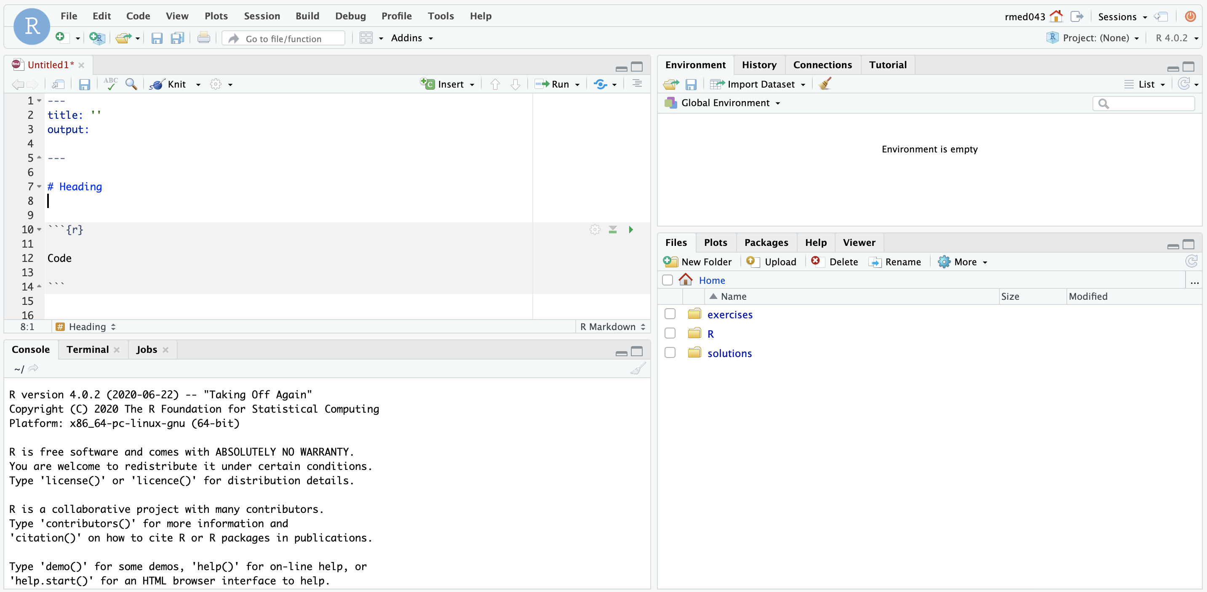
ENVIRONMENT
EDITOR
CONSOLE
MISC
Notes:
Here’s what the RStudio window looks like.
On the top left is the editor. This is where you enter code.
On the top right is the Environment. The environment allows you to look at the data that’s loaded into R. Interacting with data in the environment tab provides some of the functionality you may be familiar with from working in Excel.
The Console is on the bottom left. You can use the console quickly run an individual R command, like install a package. We won’t use the console in this course.
The pane I have labeled “MISC” has a couple different tabs. The most important one for today is the “Files” tab which shows the files we’ll be using for the course.

Slide 6
Your Turn #1
Click the link in the chat to access the RStudio training environment.
You can find your username and password in the spreadsheet Meredith attached to the course email.
Log in using your username and password.
Click “yes” once you see the RStudio IDE’s panes.
Notes:
Now it’s your turn to get logged into the RStudio training environment.
I’ll be pasting the link to the environment in the chat (http://157.230.184.87/). It’ll ask you for a username and password.
You can find your username and password in an Excel spreadsheet that’s attached to this morning’s (?) reminder email.
Please click the yes button in zoom to let us know you logged in successfully. If you are struggling to log in, please reach out in the chat and we will help you out.

Slide 7
Reproducible Data Analysis and R Markdown
Notes:
One of the most powerful aspects of working in the R environment is the ability to conduct reproducible data analyses.

Slide 8
18
The Duke Cancer Scandal
Chemo sensitivity from microarrays
Errors first, then cover-up
Clinical trials based on flawed models
Papers retracted, lawsuits settled
Notes:
To highlight the importance of reproducibility, let’s consider the following case.
In the mid-2000s, two researchers at Duke University tried to use microarray gene expression data of tumor cells to predict sensitivity to chemotherapeutic agents. This approach generated a lot of excitement at the time, and the resulting work was published in high-profile journals including Nature Medicine, JAMA, and the New England Journal.
(**) Unfortunately, there were a number of serious errors in the data analysis. The media has focused on the fact that the researchers tried to cover up investigations into these errors and press on towards clinical trials even though there were at the time open questions about the validity of the methods.
(**) Even more unfortunately, patients were enrolled in clinical trials and allocated based on flawed models, and in all likelihood patients were actually allocated to incorrect treatment arms.
(**) In the end, 18 papers were retracted, and Duke settled more than 10 lawsuits for an undisclosed amount of money.

Slide 9
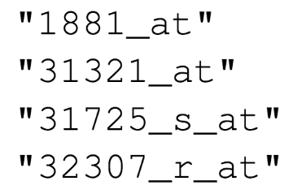
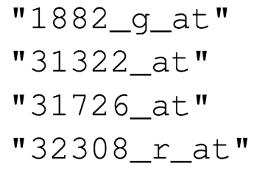

Duke
MD Anderson
Off-by-one indexing error
Notes:
Two biostatisticians at MD Anderson uncovered the mistakes that led to these retractions, in painstaking work. Let’s look at one of the errors they found.
These are a few of the hundreds of microarray probe sets – each corresponds to a gene – that the Duke investigators reported to predict sensitivity to 5-fluorouracil.
(**) And here are the probe sets that the MD Anderson team got. You can see that those two are different.
(**) If I highlight the last number of each probe, you might notice a pattern: the number of the probe set that Duke reported is always one less than the number of the probe that MD Anderson found when they re-did the analysis.
(**) This is what’s called a off-by-one indexing error and is what happens when you use a tool like Excel and accidentally miss one row. The result is that all the values in the affected column are shifted by one. This is a simple error to make, but it completely invalidates all downstream results.

Slide 10
“Common problems are simple…
Off-by-one indexing error
Sensitive / resistant label reversal
Confounding in experimental design
Inclusion of data from non-reported sources
Wrong figure shown
… and simple problems are common.”
Notes:
The off-by-one indexing error was just one of many simple errors the MD Anderson team discovered.
(**) Another type of error that was pervasive in the study was label reversal so that cell lines were labeled sensitive to a drug when they actually were resistant, and vice versa. That type of error can lead to a scenario where a patient gets the chemotherapy that would be predicted to be least beneficial.
(**) Other problems they identified were confounding, (**) inclusion of data from sources that were not reported in the paper, (**) and wrong figure shown.
These are all simple errors – you don’t have to be incompetent or negligent to make them. (**) Because these errors are so easy to make and because without good documentation or a reproducible workflow it’s hard to catch them, they are also very common.

Slide 11
Point-and-click is not reproducible
Computer code can precisely document each step of the analysis
Notes:
A key issue in this case study is that the investigators used “point and click” tools like Excel.
This prevented peers and independent investigators from catching errors in the analysis, until it was too late.
And the Duke case study is only one example where the critical barrier to reproducibility was the tendency of investigators to use graphical user interface “point-and-click” type tools. These interactive tools usually don’t record user actions and because of this, they are fundamentally not reproducible.

Slide 12
Why YOU should analyze your data reproducibly
“Can we redo the analysis with this month’s data?”
“Why do the data in Table 1 not seem to agree with Figure 2?”
“Why did I decide to omit these six samples from my analysis?”
Your closest collaborator is You from 6 months ago!
Notes:
But reproducibility doesn’t only help others. Consider the following 3 statements and ask yourself if they sound familiar.
-Can we redo the analysis with this month’s data?
-Why do the data in Table 1 not seem to agree with Figure 2?
-Why did I decide to omit these six samples from my analysis?
**Your closest collaborator is you from 6 months ago.
And if you are analyzing clinical data and might affect patient management or public health based on your findings, that makes it so much more important that you take steps to assure your analysis is free of errors.

Slide 13
Notes:
R Markdown provides a framework to tackle the reproducibility problem. It does this by allowing you to write computer code mixed in with English narrative annotation that documents the purpose of the code and details about the decisions you made in your analysis.
R Markdown is quickly becoming the gold standard for reproducible data analysis. A primary aim of this course is to teach you to use R Markdown and to encourage you to start working it into your day to day data workflows.

Slide 14
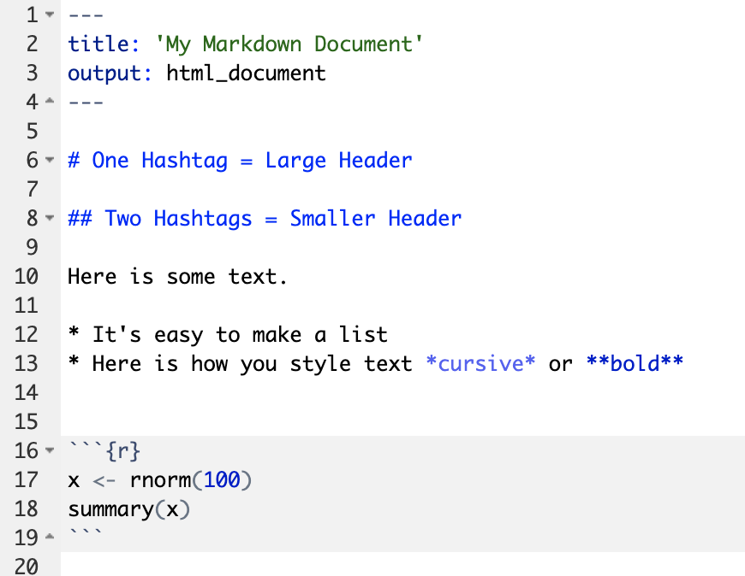
Anatomy of an R Markdown Document
Header
Header
Text (with marks)
Code chunk
Notes:
R Markdown documents are composed of 3 basic types building blocks.
**The first is the Header which includes information about the document, such as its title, author, and the desired output format when the document is rendered.
**The second type of building block is text. Text can include special kinds of marks that add styling.
**The third is code chunks. Code chunks contain R code that can be executed to output results.

Slide 15
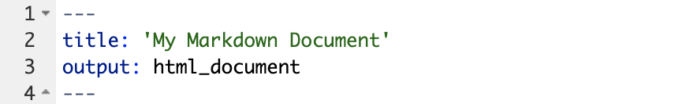
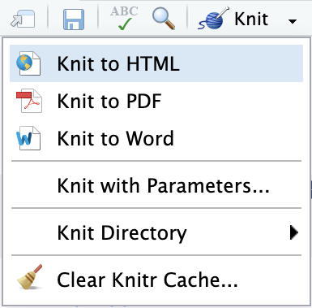
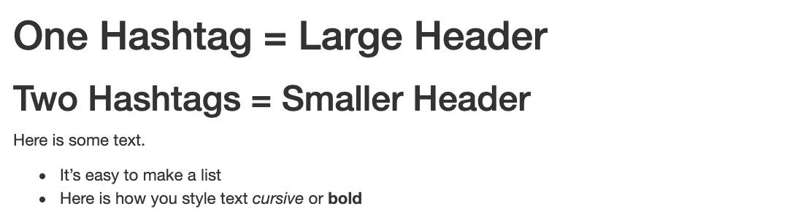
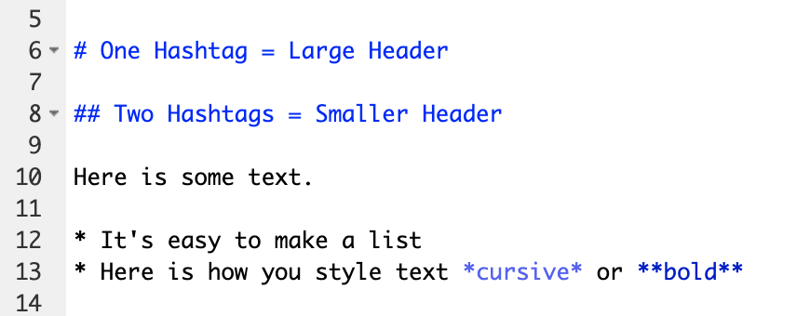
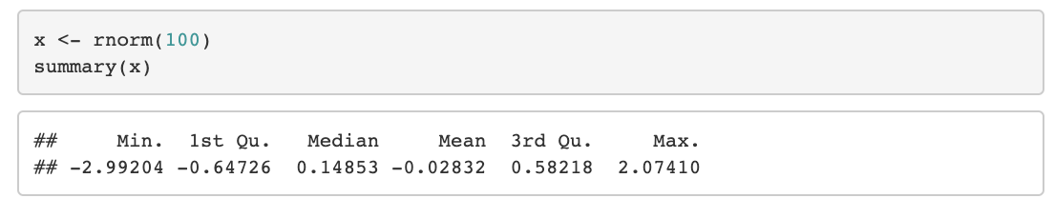
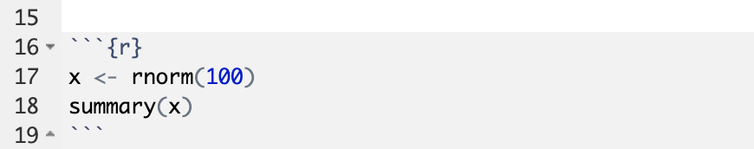
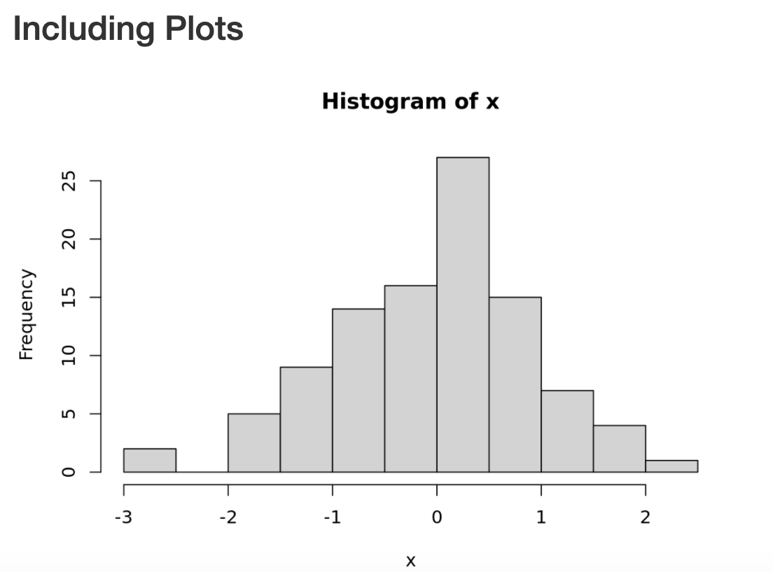
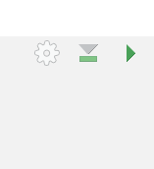
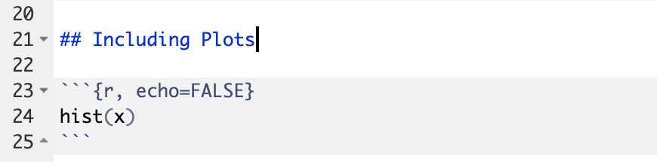
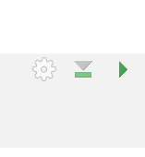
Notes:
Within the R Markdown document, we can execute a single code chunk by ** clicking the “Run Code Chunk” arrow.
And with the click of a button ** (called knitting), we can turn a R Markdown document from this ** to this.

Slide 16
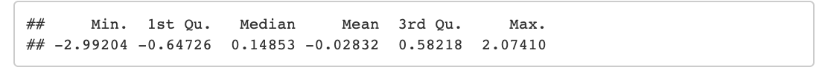
Notes:
Let’s look at this R Markdown document in greater detail.
Again the first block is header section
** The second block includes narrative text with marks.
** Then we get to the code chunks (shown in gray boxes). Don’t worry about the grammar of these particular code chunks at this point. In brief the first code chunk generates 100 normally distributed values which are performing a summary on. The knitted document shows us our code ** and the output of that code.
** The second code chunk renders a histogram visualization of that data.
The result is a neatly formatted document that includes an annotated description of our analysis, the code we used, and the output of that code.

Slide 17
Your Turn #2
Open a sample R Markdown document (File -> New File -> R Markdown).
Execute the individual code chunks by selecting the Run Current Chunk arrow.
Knit the document to HTML (Preview or Knit Button -> Knit to HTML). You may be prompted to save your R Markdown first. In this case select a name for your document and click save. Review the knitted document.
Notes:
It’s your turn again.
Follow the instructions in Your Turn #2 to
-open an R Mardown document
-execute individual code chunks
-knit the document
We will meet back in 3 minutes to review this exercise together.

Slide 18
Importing Data
Notes:
Now that we are familiar with how to create R Markdown documents we can begin the process of performing data analysis in R in earnest by importing a clinical data set.

Slide 19
The Data Analysis Pipeline
From R for Data Science (https://r4ds.had.co.nz/introduction.html)
Notes:
This diagram may look familiar, you saw it in the Welcome presentation.
The first step in the data analysis pipeline is to load the data into the environment so we can begin to tidy and transform that data.
In today’s course we will be using a de-identified data set consisting of COVID-19 laboratory test results from CHOP’s infectious disease diagnostics lab. This data is stored as a CSV file.

Slide 20

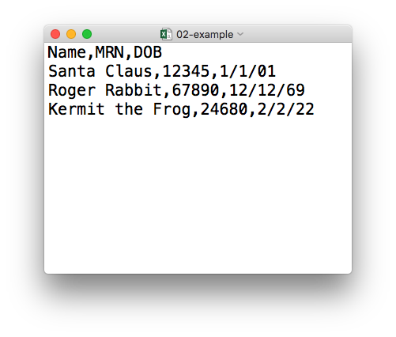
plain text (“flat”) file
csv
rectangular structure
header row
Notes:
So what’s a CSV file? CSV stands for comma-separated values.
** A CSV file is a plain text file, which means you can open it in a text editor and look at it.
Here we have a CSV file with the names, medical record numbers, and dates of birth for three fictional “patients”
** This data structure is called rectangular because it falls into rows and columns, where each row has the same # of columns, and each columns has the same # of rows.
** Also note that this particular CSV file has a header row that instead of data, has a descriptor of what kinds of data are found in each column. CSV files often but not always have such a header row.

Slide 21
Tidyverse: R Packages for Data Science
A consistent way to organize data
Human readable, concise, consistent code
Build pipelines from atomic data analysis steps
Notes:
To import our CSV data, we need some additional data analysis tools. In this course, we will be leveraging the Tidyverse.
The Tidyverse is a set of tools that has become the de facto standard for doing data science with R.
The basic tenets of “tidy” data analysis include:
Data should be organized in a consistent, standardized way. Each row is an observation, and each column is a variable. This is a very common way to organize data in a spreadsheet and might sound familiar from how you may already organize data in tools like Excel.
Programming code that acts on the data should be consistent, concise, and sound like human language as much as possible.
Each data analysis can be broken down into a series of atomic steps, such as “select this column” or ”arrange the data by the values in that column”. An arbitrarily complex data analysis can be broken down as a pipeline of atomic steps.

Slide 22
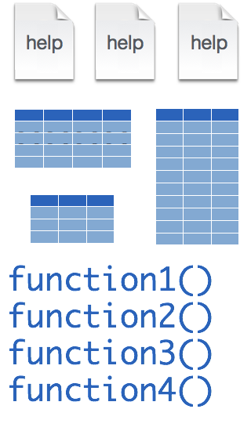
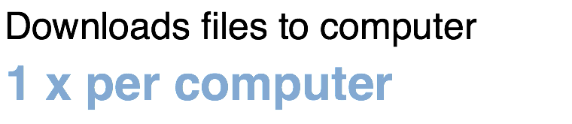
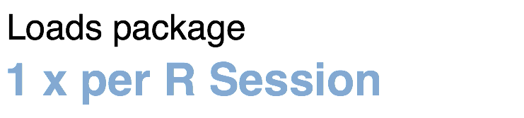
Installing and loading R packages
tidyverse
install.packages("tidyverse")
library("tidyverse")
Notes:
The Tidyverse is package (a collection of functions, data, and help documentation) that we can use to extend the functionality of R.
You can download and install a package with the command install.packages. So let’s say you want to install a package named “tidyverse”. You go to the R Console and type install.packages(“tidyverse”). Each package you want to use needs to be installed only once on each computer. On our RStudio Server, you won’t need to install any packages for this course (I have installed them for you). But when you go on to use R in the future, you will have to install packages.
After you’ve installed the package, in order to use the functions that it provides, you also need to load the package into the computer’s memory. This is done with the command “library”. So to enable all the functions in the “tidyverse” package, you type library(“tidyverse”). Packages remain loaded until you quit or restart the R program. So every time you start a new R session you have to load each package that you want to use again.
So these are the first two R commands we’ve covered - install.packages and library.
One of the great things about R is that there are tens of thousands of packages,
(**) and essentially all of them are free to download and use, including all the packages I’m introducing in this course.

Slide 23

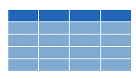
read_csv()
data_frame <- read_csv(file_name)
csv
Notes:
We can import CSV files using the read_csv() function.
Here is a template for how to use the read_csv function to read a CSV file into a data frame object. A data frame is a type of object that works like a spreadsheet.
You start with the name of the object then you have this left-ward arrow looking symbol then read_csv and then the file name in parentheses.

Slide 24
function
(does stuff)
data_frame <- read_csv(file_name)
Notes:
This code construct is exceedingly common in R, so I want to spend a few minutes exploring it together
read_csv() is a function. Remember that functions are defined in packages. We loaded the Tidyverse package to be able to use the read_csv function.
You may be familiar with functions from math class. A function takes an input, say an ‘x’ value and returns an output, say a ’y’ value. Functions in computer programming also take inputs and return outputs. But the inputs and outputs here are the arguments and objects that exist within the context of a programming language.
For read_csv, the input is the file name of a CSV file; and the output is a data frame with the contents of the file.

Slide 25
function
(does stuff)
argument
(input)
data_frame <- read_csv(file_name)
Notes:
The input that goes into a function is called an argument. The argument to a function gets put in parentheses.
A function can have zero, one, or many arguments. If there is more than one argument, we use commas to separate them. We’ll see examples of that later.

Slide 26
object
(stores output)
function
(does stuff)
argument
(input)
data_frame <- read_csv(file_name)
Notes:
- The read_csv function outputs a data frame, but if you want to *capture* that data frame inside of a named object so you can use it as the input for other functions, for example to summarize or visualize your data.

Slide 27
object
(stores output)
function
(does stuff)
argument
(input)
data_frame <- read_csv(file_name)
assignment operator
(“gets”)
Notes:
To put the output of the read_csv function into a named object, we use the assignment operator.
The assignment operator is a smaller-than followed by a dash and looks kind of like an arrow pointing left. It’s usually pronounces “gets.” So this line of code reads: data_frame gets read_csv of file_name.

Slide 28
read_csv()
data frame to read data into
name of
CSV file
covid_testing <- read_csv("covid_testing.csv")
covid_testing
covid_testing.csv
csv
Notes:
Let’s put these pieces together to load our covid data set.
This line of code reads the “covid_testing gets read_csv of covid_testing.csv”.
You might notice that one of the objects is put in quotes and the other one isn't.
To be honest, quotes in R can be super confusing. A couple of rules are: names of objects such as data frames don't get quotes. On the other hand, literal file names are always put in quotes. Other times, either quoting or not quoting works. I promise, with practice this kind of stuff becomes second nature.

Slide 29
Your Turn #3
In the MISC pane, click on the folder exercises.
Open the R Markdown file titled
01 – Introduction.Rmd
In the Editor pane, follow the instructions to complete the exercise.
Notes:
One final your turn in this session.
In this exercise, I’m going to ask you to open an R Markdown document and follow the instructions contained in that document to load and explore our data set.
We will meet back in 5 minutes to go over this exercise together.

Slide 30
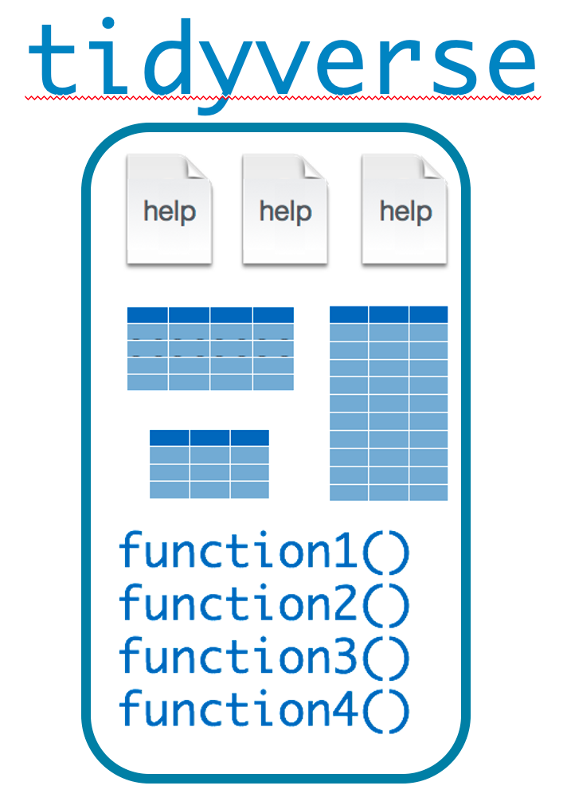

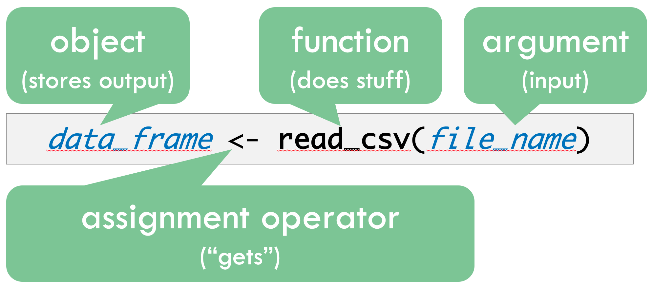
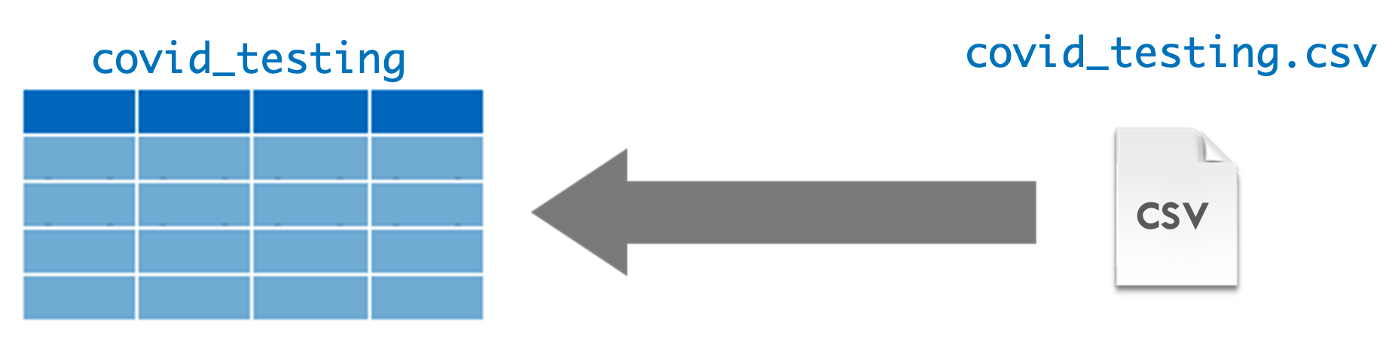
Recap
Programming Language
IDE
(Editor)
Document Format
Packages extend the functionality of R. Install with install.packages() and load with library().
Functions do stuff. They accept Arguments as input and return an Output. Capture an output in an Object using the assignment operator ( <- ).
Importing Data is the first step of the data analysis pipeline. Use the read_csv() function from the tidyverse package to import data stored in a CSV file.
Notes:
To recap what we have covered in this session--
We started by defining and differentiating R (the programming language) from RStudio (the development environment) from R Markdown (the document format we use for reproducible data analysis).
In addition to learning to create and edit R Markdown documents we discussed some basic coding vocabulary including:
-Packages (such as the Tidyverse) which extend the functionality of R. We us the install.packages() function to install packages, and the library() function to load them into the environment.
-Functions do stuff on our behalf, they accept arguments, and we can store their output in named objects using the assignment operator
-Finally we discussed and practiced importing data using the read_csv() function from the tidyverse, and explored this data visually.

Slide 31
What else?
Notes:
At the end of each session I’m including a “what else” section to introduce you to ”what else” there is out there for your to explore and learn about after completing this course.

Slide 32
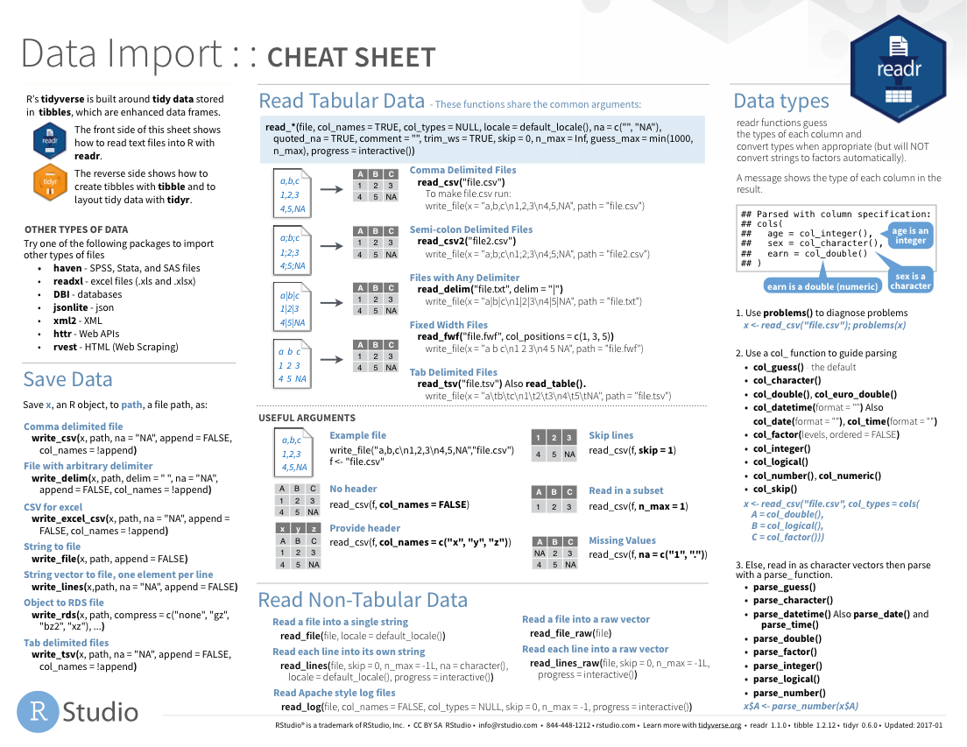
https://rstudio.com/resources/cheatsheets/
Notes:
RStudio the company publishes a number of cheat sheets which come in handy for data analysis.
Relevant to this session, the Data Import cheat sheet helps with importing data from file types similar to CSV but with other delimiters.
The Data Import cheat sheet is linked on the course website.

Slide 33
Notes:
There are a huge number of other packages out there designed to deal with a different file formats, and the most important ones are shown here:
Readxl: Excel
Haven: SPSS, Stat, and SAS files
Googlesheets
Rvest: scrape the web
Jsonlite: JSON data and APIs on the web

Slide 34
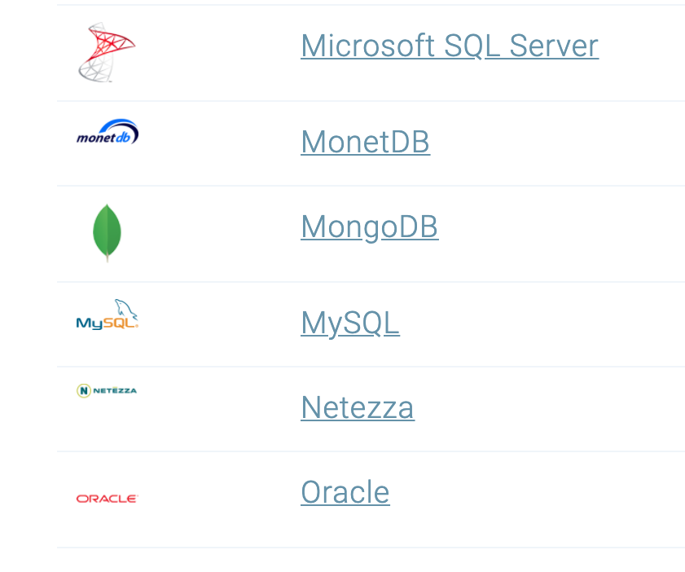
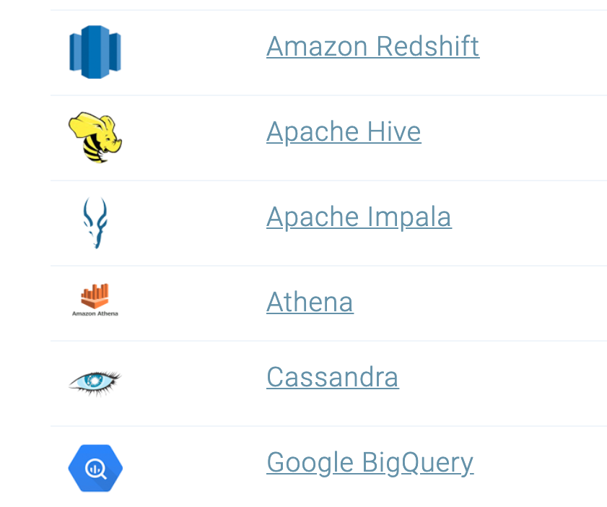
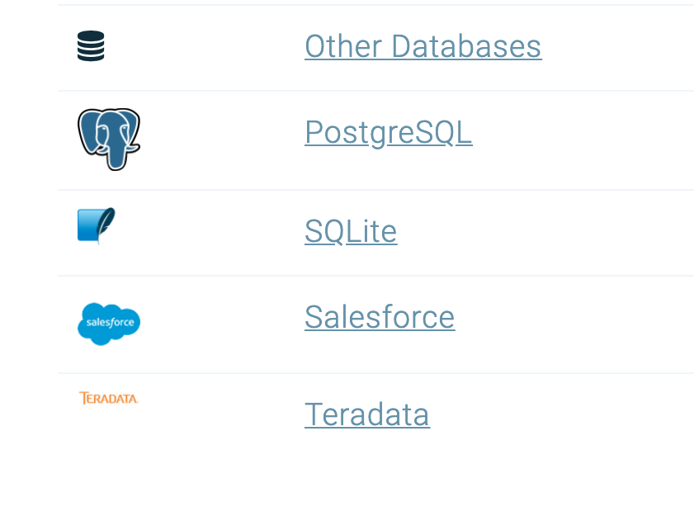

Databases
https://db.rstudio.com/databases/
Notes:
You can also connect to a large number of databases directly in R to pull your data. For example, CHOP uses Netezza for the Clinical Data Warehouse, Oracle for Epic Clarity, and REDcap for a large number of research projects, all of which have R interfaces.

Slide 35





Notes:
In this lesson you saw how you can “knit” your R Markdown document into an HTML file.
In addition to HTML, R Markdown documents can be “knitted” into a number of additional formats including PDF, Microsoft Word, PowerPoint, and even interactive dashboards. We will look at dashboards in greater detail later in the course.

Slide 36
R Interface to Python
```{python}
import pandas
covid_testing.info()
```
Notes:
Finally, I wanted to mention again that in addition to R, R Markdown supports many other programming languages, including Python.
So you can mix code chunks written in R with code chunks written in Python, and here on the side is an example of what that could look like.

